Slide 1
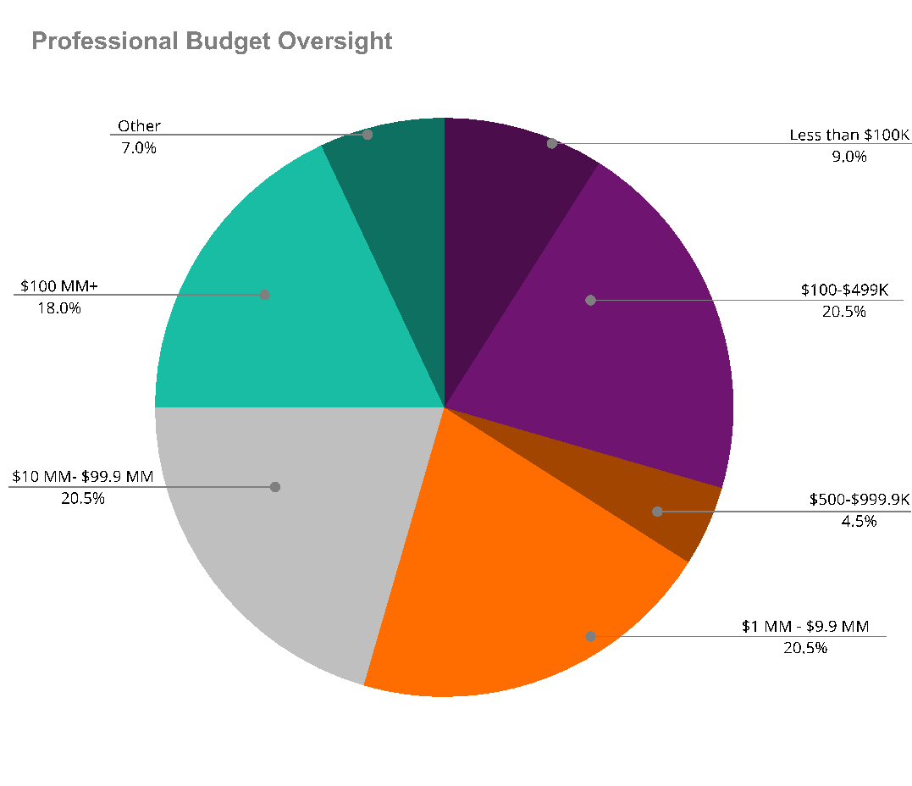
Executive Women 4Christ Sponsorship Packages
Our annual Executive Women 4Christ Forum is a unique experience where Executive level, Christian women gather to elevate other women spiritually, intellectually, and relationally with the goal of making a bold difference in the world.
The profile is a Christ-follower first, at some point in her career she has held high-level leadership positions in her area of responsibility or currently serves as a leader in her own business or an organization with million-dollar annual revenues.
You’ll gain significant exposure to executive women who:
Have impactful decision-making and buying power
Have a network of other executives whom they influence
Have access to large teams as part of their leadership role
We hope you’ll join us at this annual event on the second weekend of June at the Broadmoor Hotel in Colorado Springs, Colorado.

Slide 2
EW4C Sponsorship Options
Sponsorship Package Includes | Platinum $25.000 | Gold $10.000 | Silver $5.000 | Bronze $2.500
Executive speaking engagement session at Forum | 1
One-on-one mentoring (10 weeks) with a 4word Mentor | 2 | 1
Forum Registration and Attendance for one Executive Woman | 1 | 1
Podcasts dedicated to research results and outcomes | 2 | 1
Blog posts bringing exposure to new audiences and customer demographics | 2 | 2 | 1
Promo ads on 4word social media channels | x | x | x
Full page brand recognition on EW4C programming materials | x | x | x | x
On-stage verbal recognition during the seated meal | x | x | x | x
Opportunity to promote organization with prominent signage at the event | x | x | x | x
Opportunity to place a premier item in swag bags | x | x | x | x
First right of refusal for presenting sponsorships at future EW4C Forums | x | x

